Slide 1
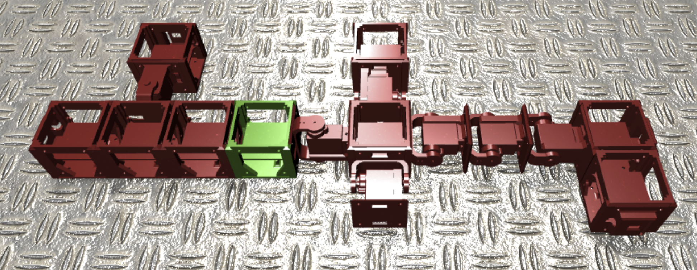
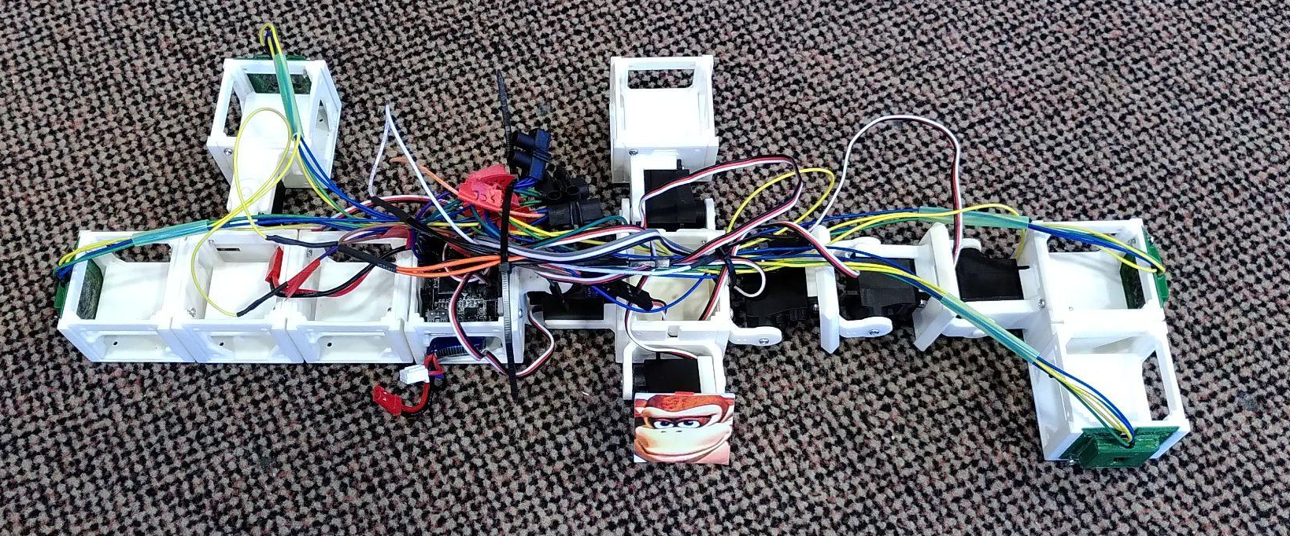
RoboGen Project: Group 7
Figure 1: Final image of robot body
M. Hassan,
L. Zunino,
L. Duggan,
H. Sprumont,
MICRO-515 Evolutionary robotics
29.05.2022
Figure 2: Final image of robot body (real)

Slide 2
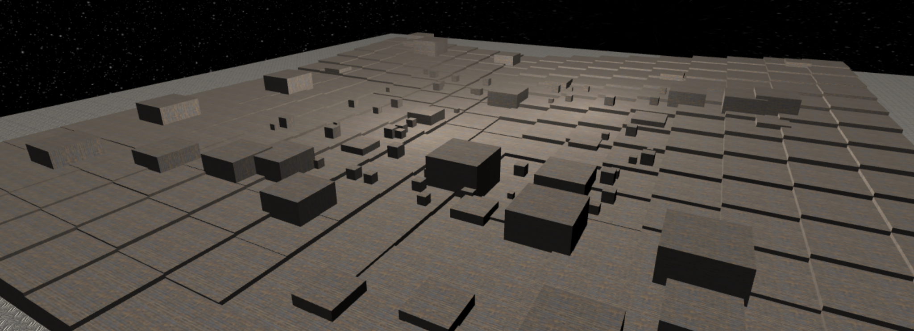
Introduction: Mars exploration rover
Locomotion on uneven terrain
Stability of the core component →
Obstacle avoidance
Scientific approach / Repeatability
Exploring the parameters of Robogen
Figure 3: Grand challenge arena

Slide 3
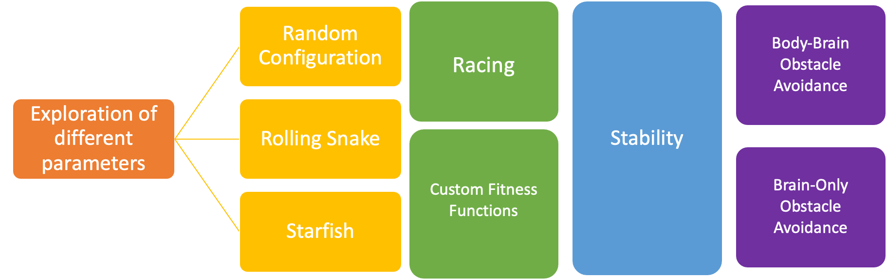
Experimental Method:
Figure 4 : Project flowchart

Slide 4
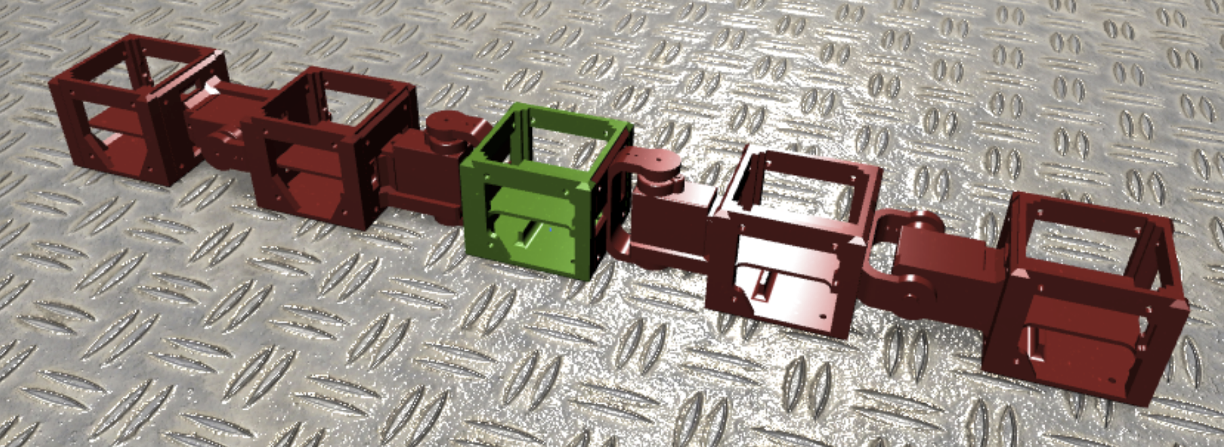
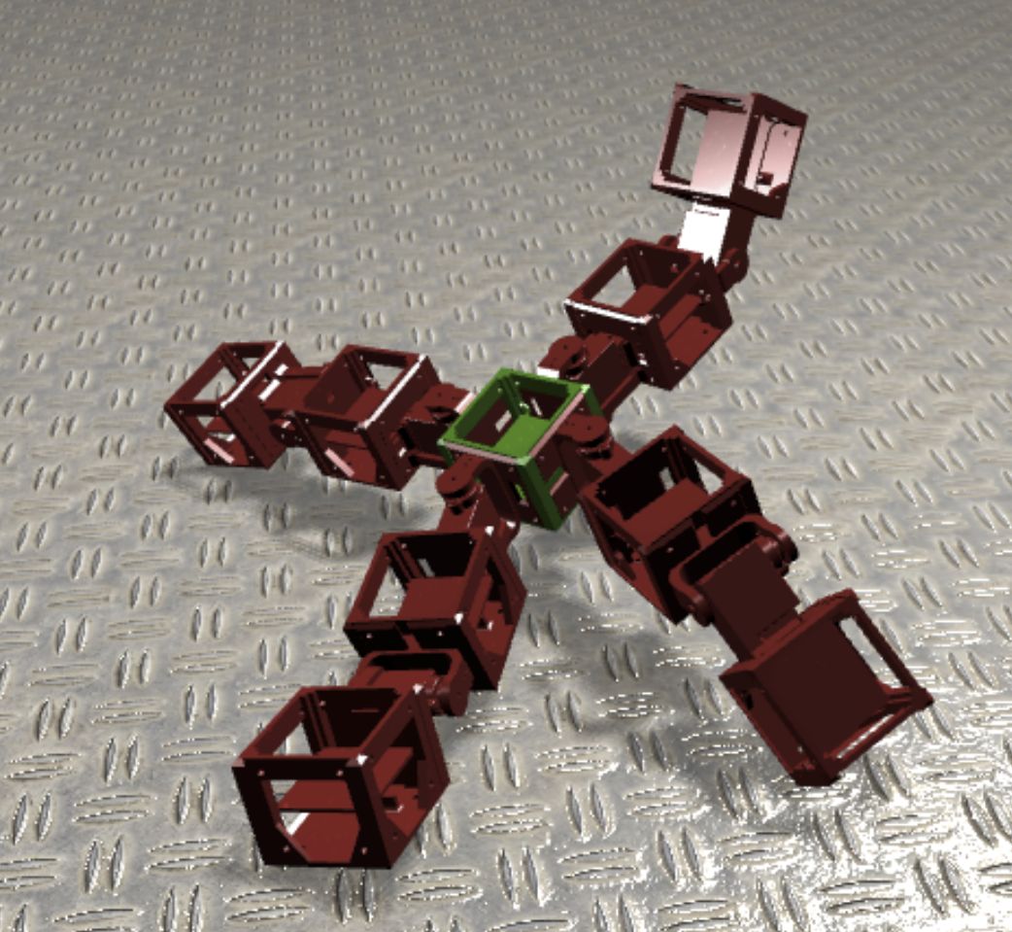
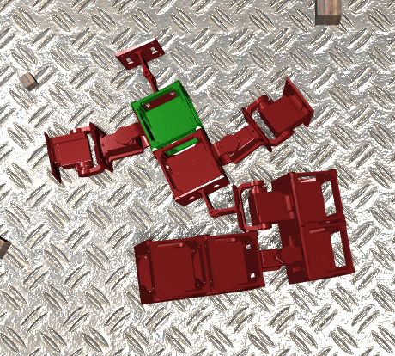
Experimental Method: Starting robot
2 Random starts:
More exploration
Surprises !
Rolling snake:
Oscillators only
Good racing score
Simple geometry
Starfish:
Oscillators only
Good racing score
Advanced geometry
Figure 5 : Starting robots and one of our random results

Slide 5
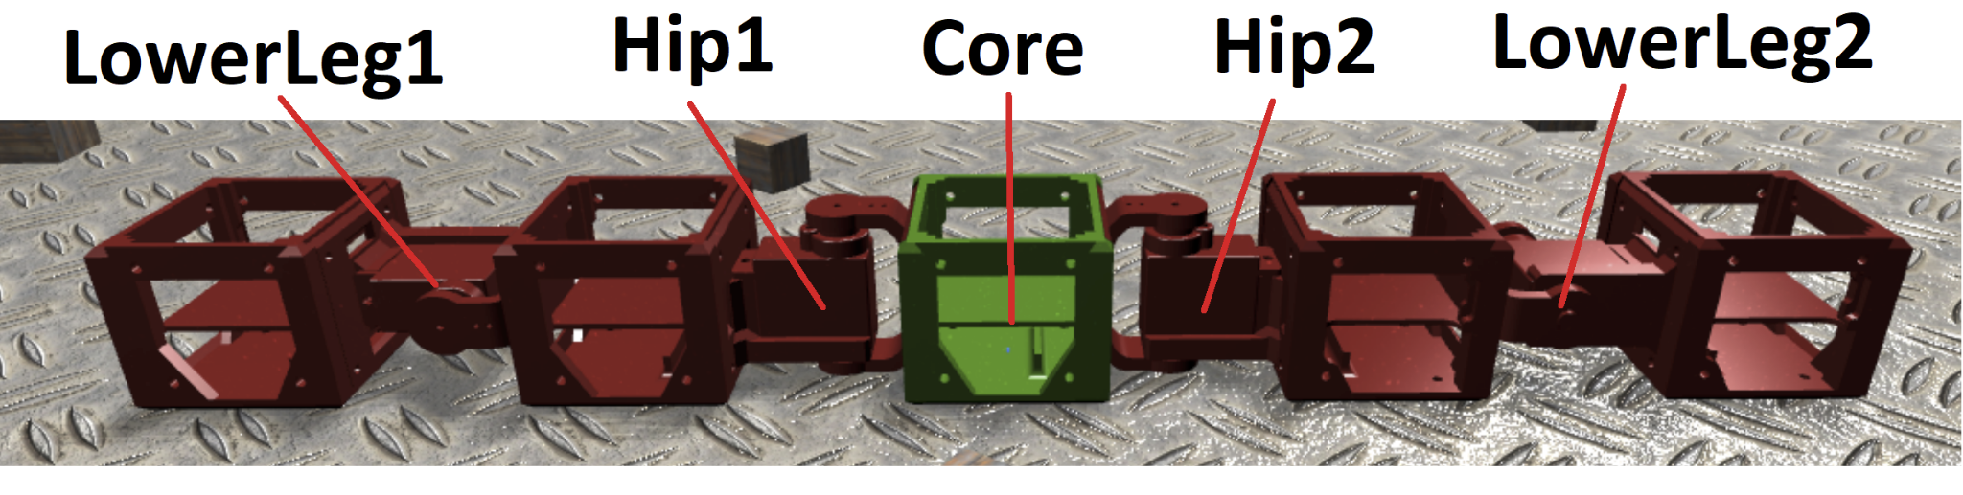
Experimental Method: Starting robots (bis)
2 Random starts:
More exploration
Surprises !
Rolling snake:
Oscillators only
Good racing score
Simple geometry
Starfish:
Oscillators only
Good racing score
Advanced geometry
Oscillators | LowerLeg1 | Hip1 | Hip2 | LowerLeg2
Period | 0.8 | 0.8 | 0.8 | 0.8
Offset | 0.2 | -0.8 | -0.95 | -1
Amplitude | 1 | 1 | 1 | 1
Table 1 : Rolling snake oscillator parameters
Figure 6 : Rolling snake core and actuators

Slide 6
Experimental Method: Starting robots (bis)
Oscillators | Hip 1 | Hip 2 | Hip3 | Hip 4 | knee1 | knee 2 | knee 3 | knee 4
Period | 2 | 2 | 2 | 2 | 2 | 2 | 2 | 2
Offset | 0 | 0 | 0 | 0 | 0 | 0 | 0 | 0
Amplitude | 1 | 1 | 1 | 1 | 1 | 1 | 1 | 1
2 Random starts:
More exploration
Surprises !
Rolling snake:
Oscillators only
Good racing score
Simple geometry
Starfish:
Oscillators only
Good racing score
Advanced geometry
Table 2 : Starfish starting oscillator parameters
Oscillators | Hip 1 | Hip 2 | Hip3 | Hip 4 | knee1 | knee 2 | knee 3 | knee 4
Period | 1.87 | 2 | 1.83 | 2 | 1.92 | 1.99 | 1.61 | 2
Offset | 1 | -0.57 | -0.89 | 0.41 | 0.38 | 0.17 | 0.24 | 0.64
Amplitude | 1 | 0.83 | 0.78 | 0.93 | 1 | 1 | 1 | 1
Table 3 : Brain-only Evolved Starfish

Slide 7
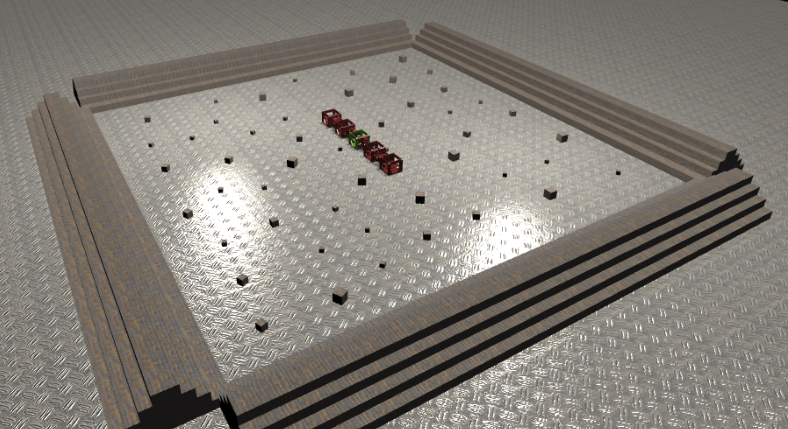
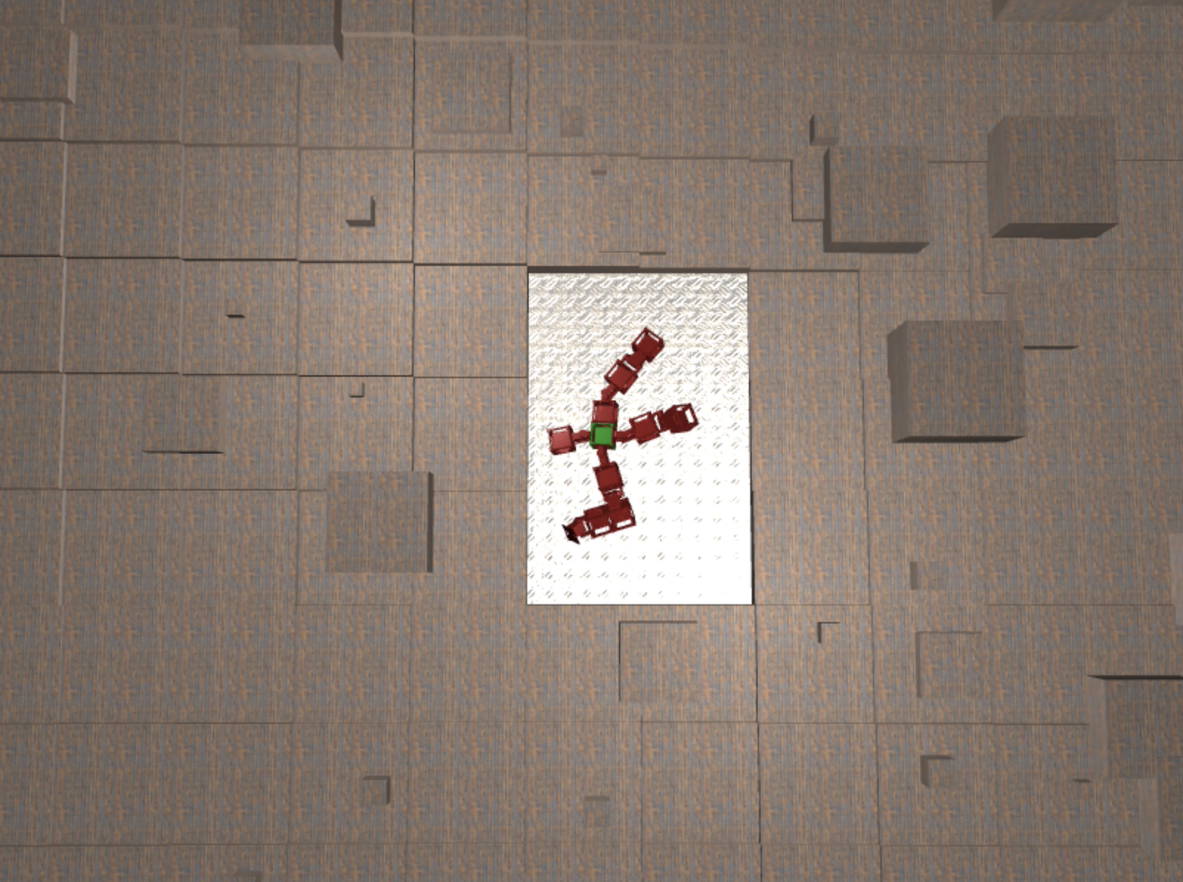
Experimental Method: Initial parameters
Number of generations | 200
Mu | 25
Lambda | 100
Replacement strat | plus
Tournament size | 3
pBrainMutate | 0.5
BrainSigma | 0.9
Table 4 : Evolution parameters
Motor noise | Sensor noise | Simulation time (s) | max direction shifts per second
0.03 | 0.03 | 12 | 16
Table 5 : Simulation parameters
Figure 7 : Arena of evolutionary step 1

Slide 8
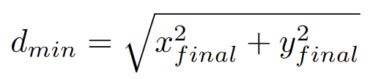
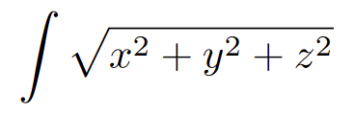
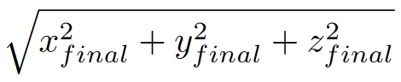
Experimental Method: Locomotion
A variety of fitness functions:
Racing (Final distance of the closest element)
Integral of Core position
Final Core position
Final Core position + Stability
Minimum distance + Stability

Slide 9
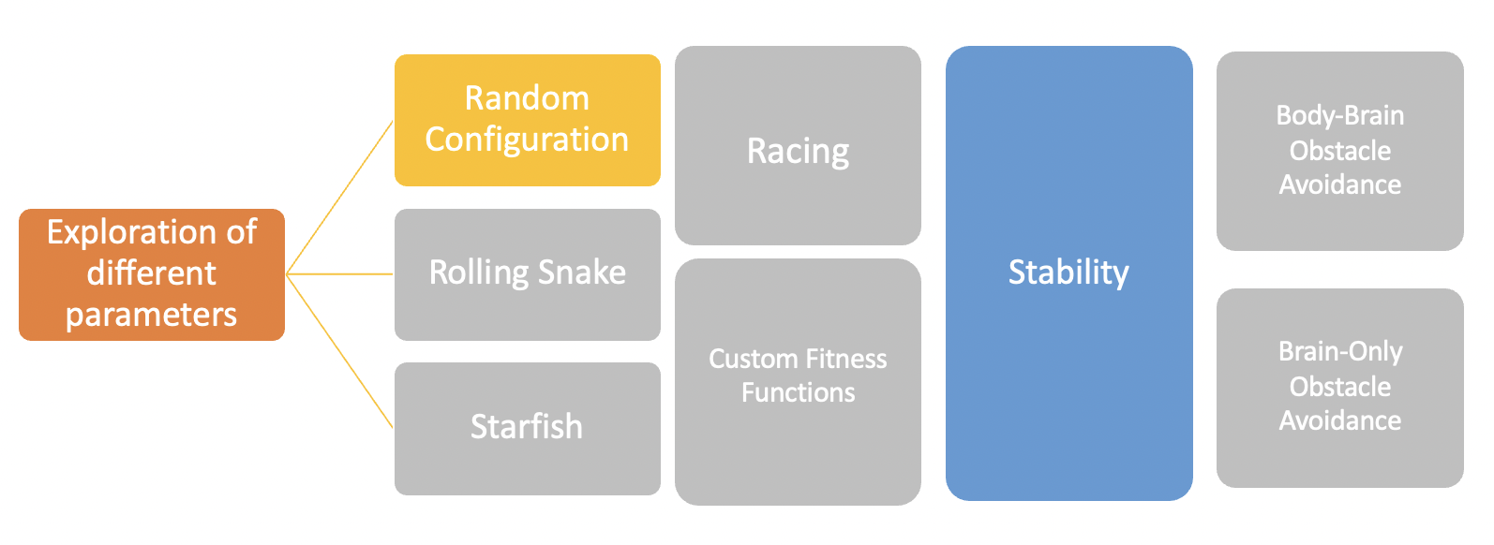
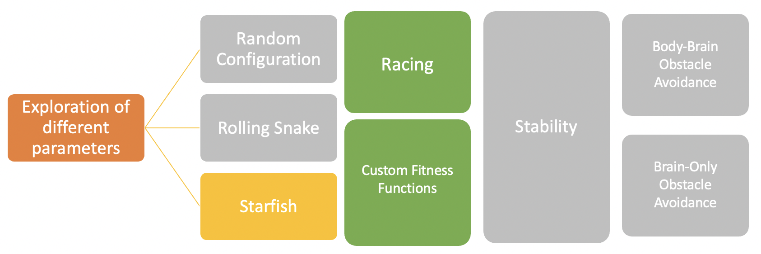
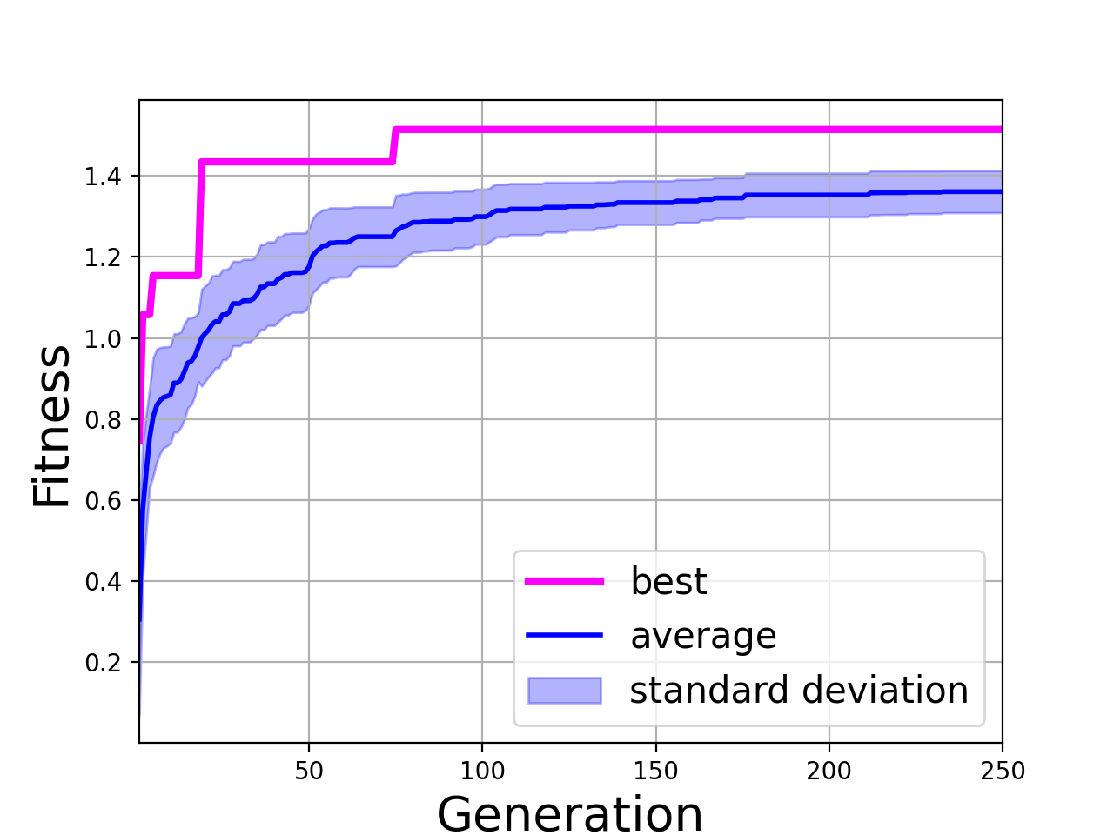
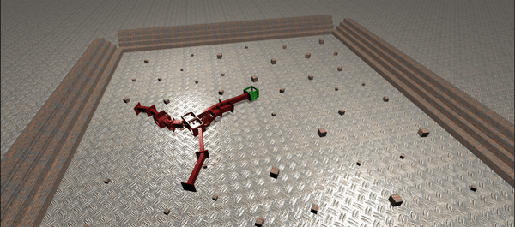
Intermediate results: Random configuration
Figure 8: Fitness evolution: Max (x,y) distance + max acceleration, roll, pitch fitness function
Figure 9 : Robot at the end of the evolution

Slide 10
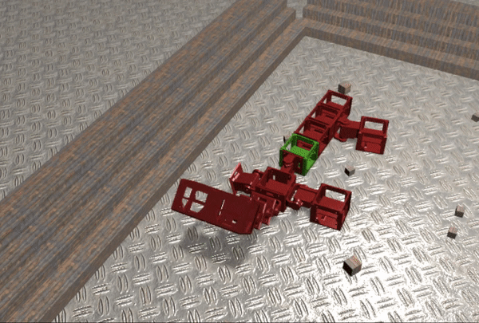
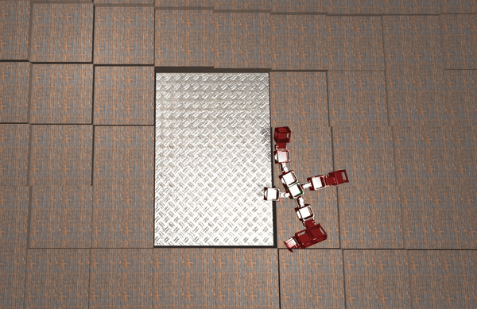
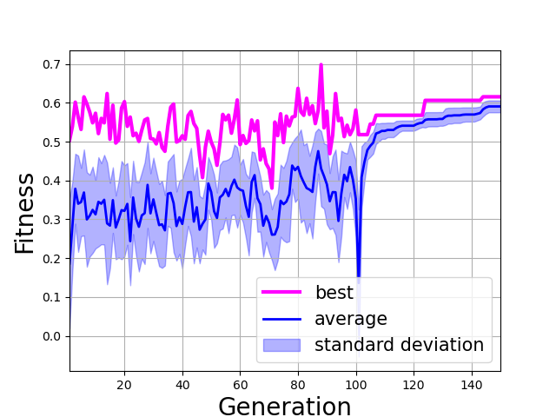
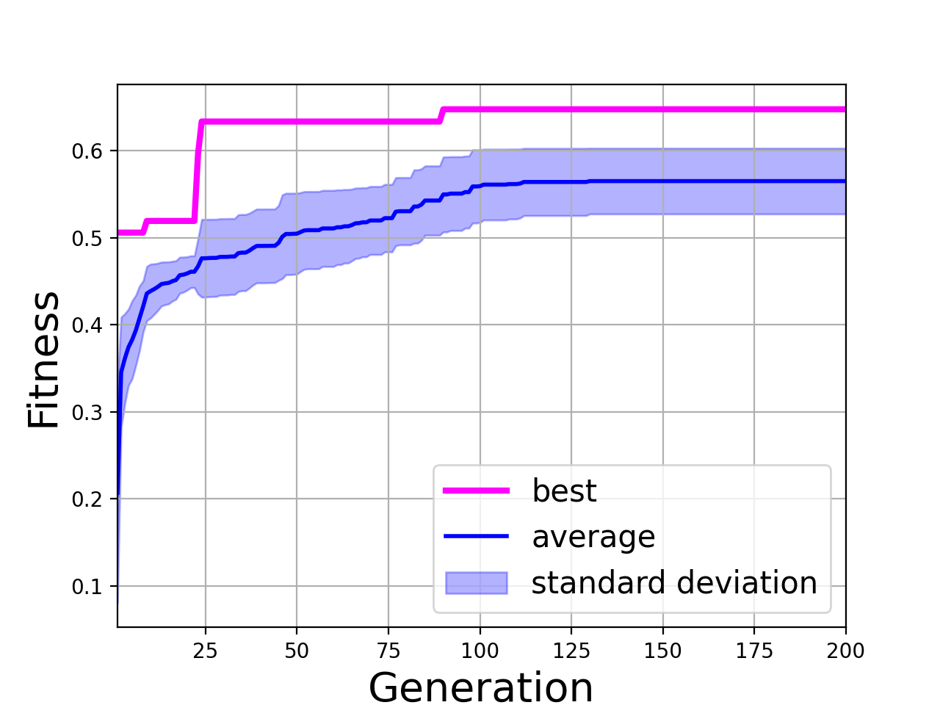
Intermediate results: Snake and starfish
GorillaBot :
Starfish:
↑ ↑
Figure 10 : GorillaBot and Starfish in simulation
(Don’t judge them, they’ve been through a lot)
← Figure 11 : Fitness evolution for both robots →

Slide 11
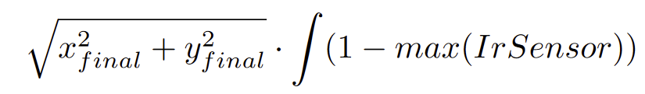
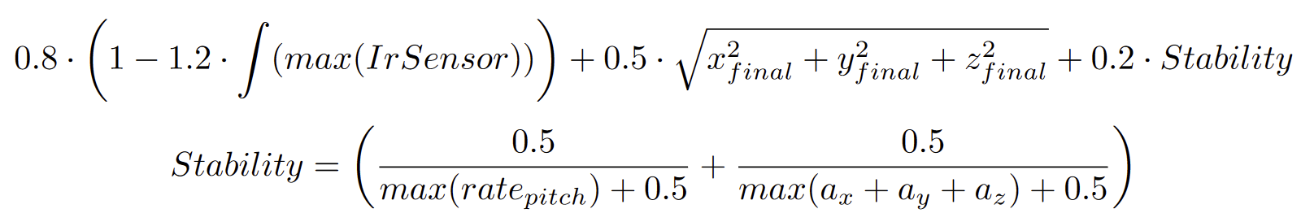
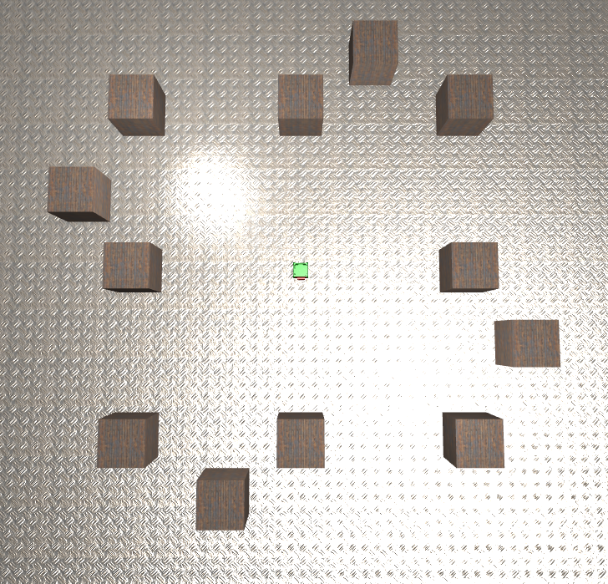
Experimental Method: Obstacle avoidance
Brain evolution, manual sensor placement:
Fitness functions:
1.
2.
Body and brain evolution, implicit OA:
Fitness function: Racing scenario with conditions on minimum number of sensors and no obstacle removal
Constant battle with the robot’s exploits (no IR sensors on robot, obstacle despawning, lucky starting position, ...)
Figure 12 : Arena for implicit obstacle avoidance

Slide 12
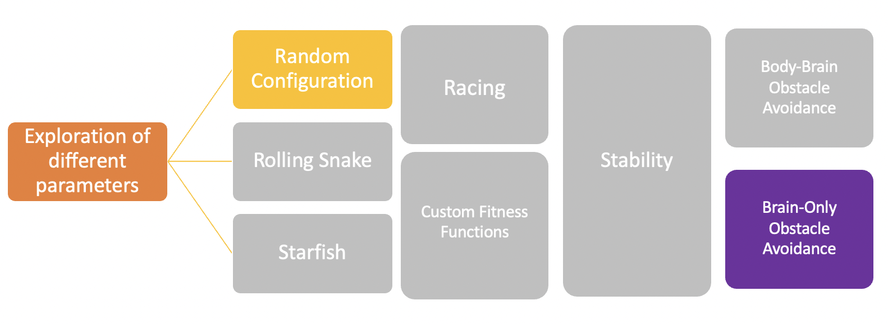
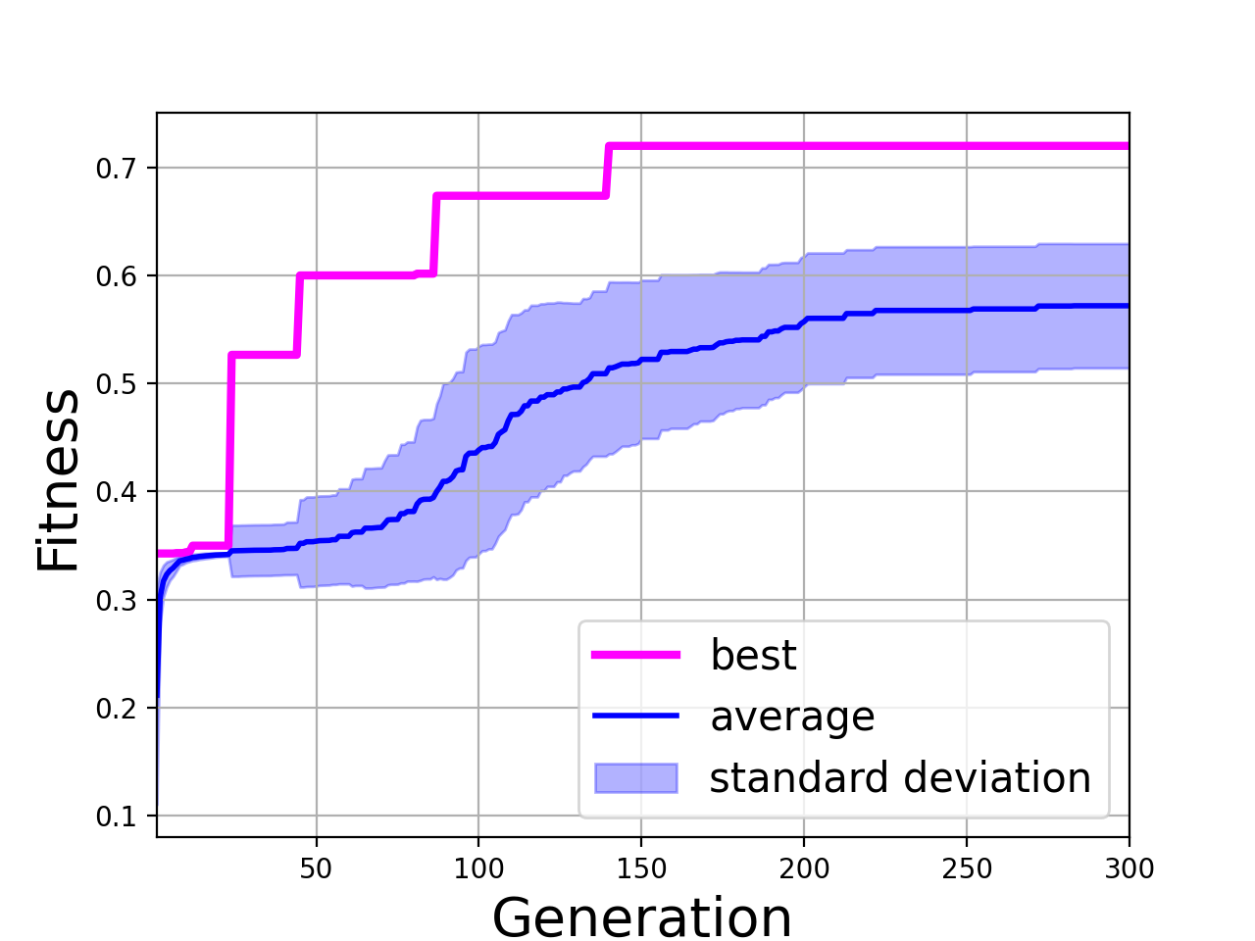
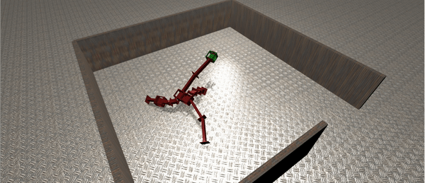
Results
Figure 13 : Fitness evolution : Brain-only OA fitness function
Figure 14 : Robot at the end of the evolution

Slide 13
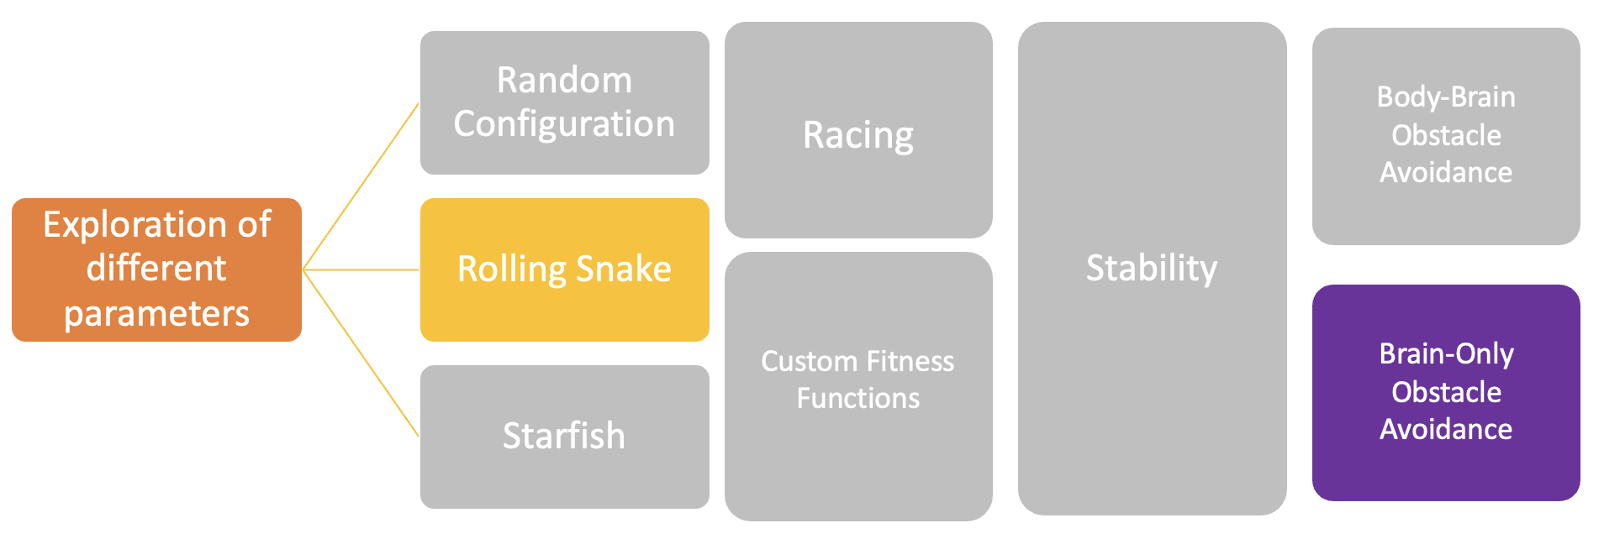
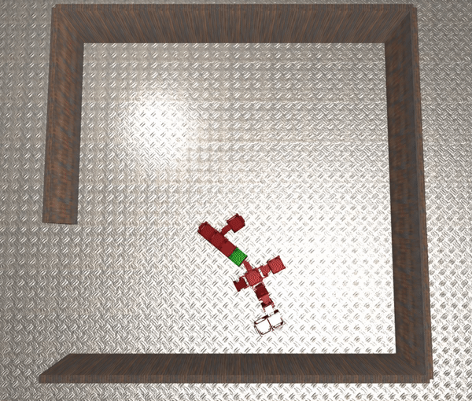
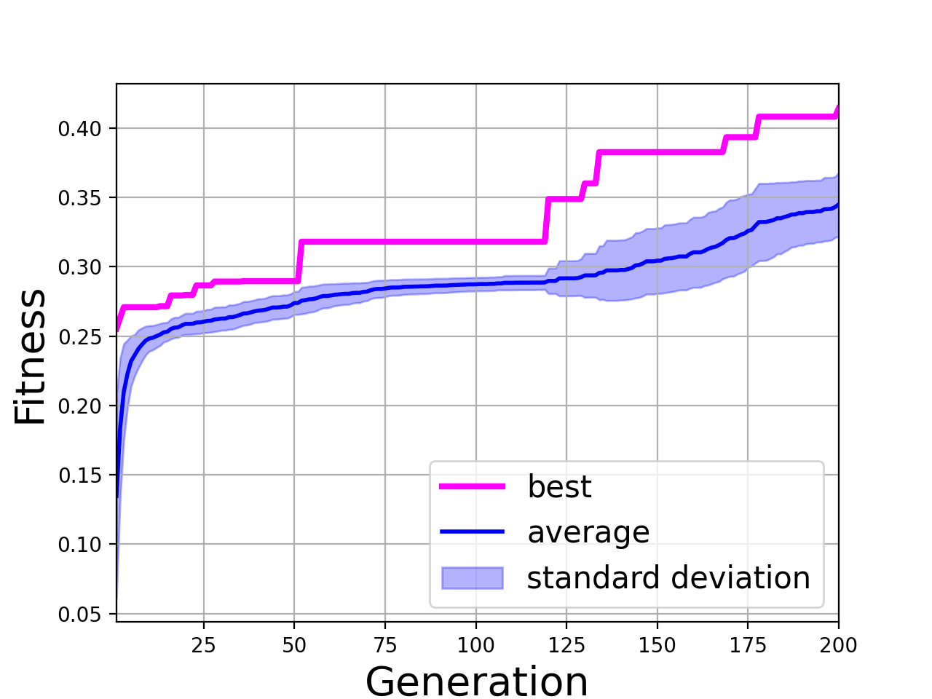
Results
Figure 15 : Fitness evolution : Brain-only OA fitness function
Figure 16 : Robot at the end of the evolution

Slide 14
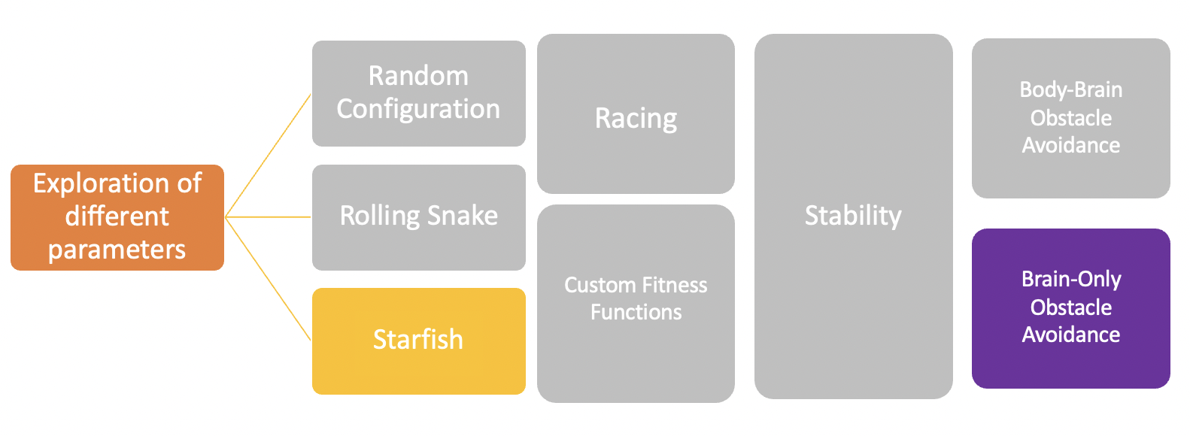
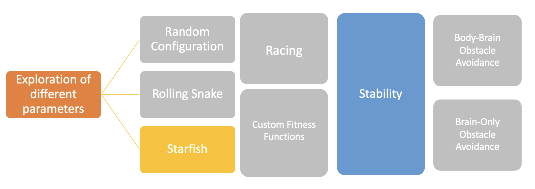
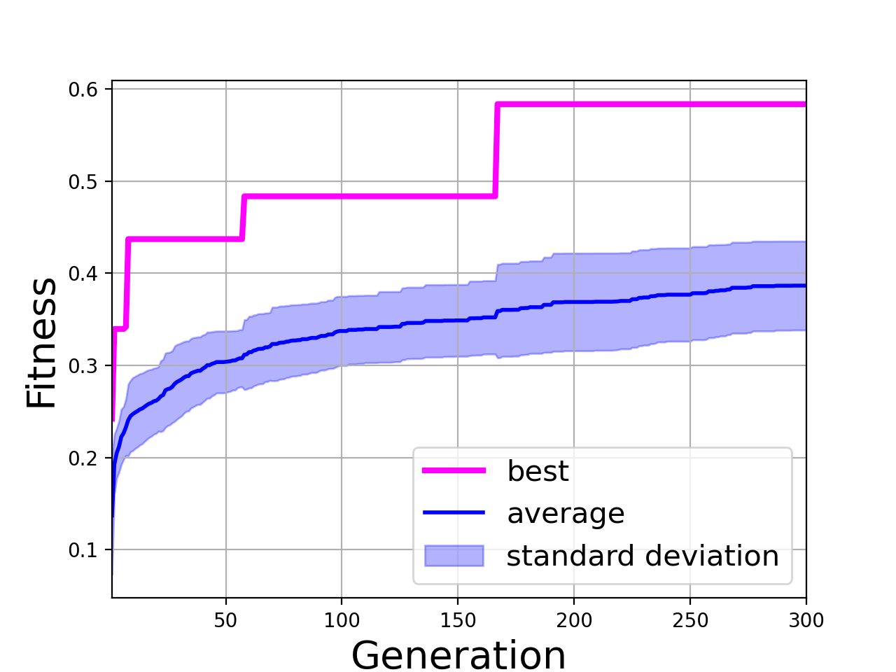
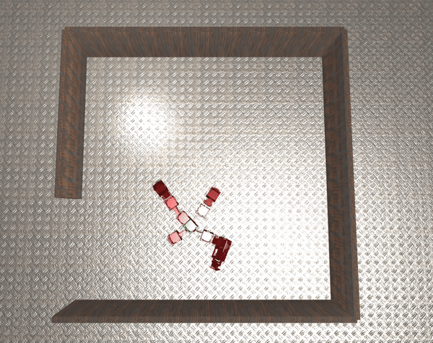
Results
Figure 17 : Fitness evolution : Brain-only OA fitness function
Figure 18 : Robot at the end of the evolution

Slide 15
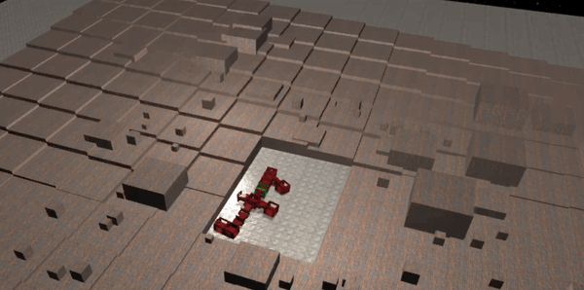
Video of GorillaBot - Simulation (2x speed)

Slide 16
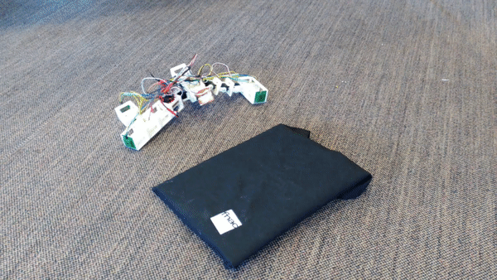
Video of GorillaBot - Real robot

Slide 17
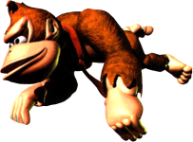
Conclusion
Observations
Simpler fitness functions worked better
Random start has greater variability in results
Repeatability is more guaranteed with non-random start configurations (GorillaBot: obtained ⅖ times)
Evolutionary algorithm is opportunistic
Figure 19 : Artistic depiction of GorillaBot
Future works, if we had more time :
Longer evolution with more starting positions
Explore more the implicit OA (tweaking arenas, …)
More random starts (funny results)
Train on different arena for more general results

Slide 18
Workload distribution
 | M. Hassan | L. Zunino | L. Duggan | H. Sprumont
Starting robot | Starfish | Random | Random | Snake
Final OA | Starfish + Gorilla | Random |  | Gorilla
Robot build |  |  | Body + Sensors | Body

